Slide 1
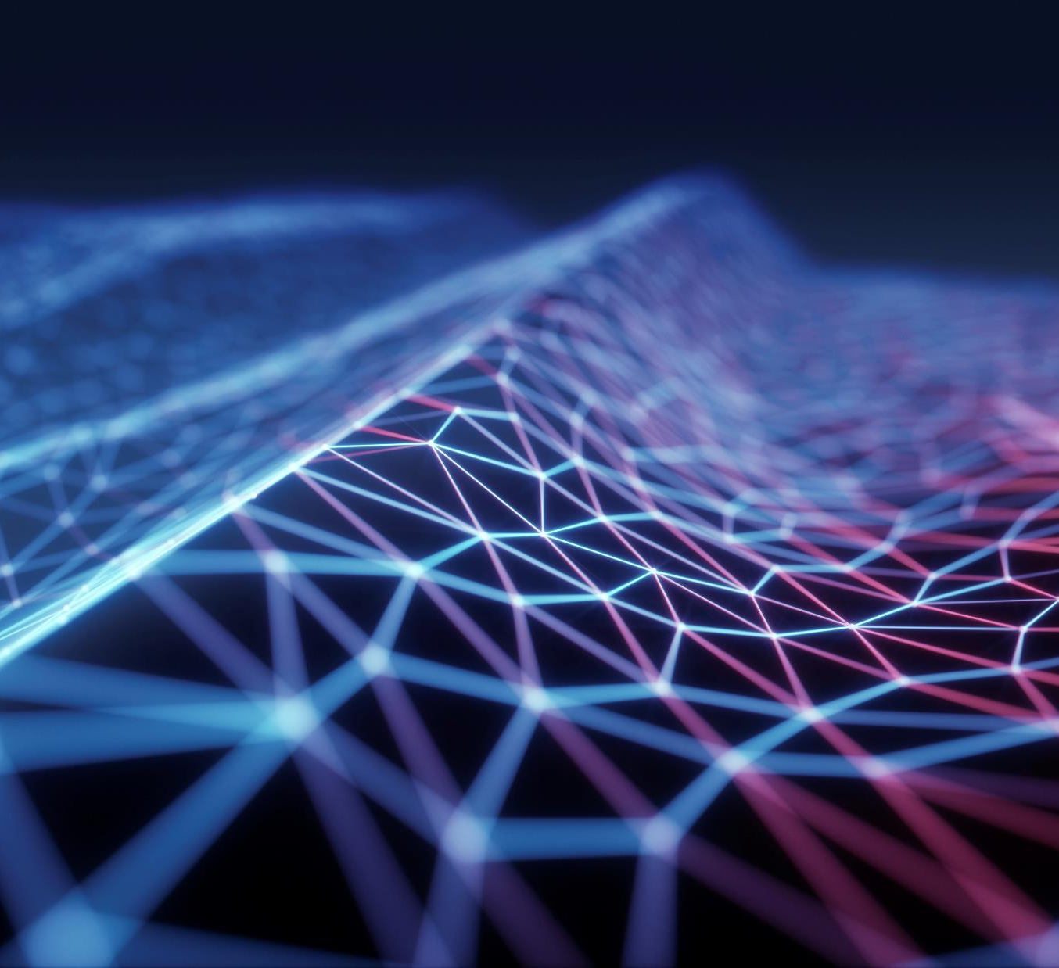
Upcoming Technologies you need to look out for
By Rishi Kumar thakur (A40318052)
CSE (6th SEM)

Slide 2

Change is the only constant and Technology is evolving quickly and we need to identify it fast to invest our time on it before it opens up to everyone for a profit. So here is a list of upcoming technology that needs your time and attention

Slide 3
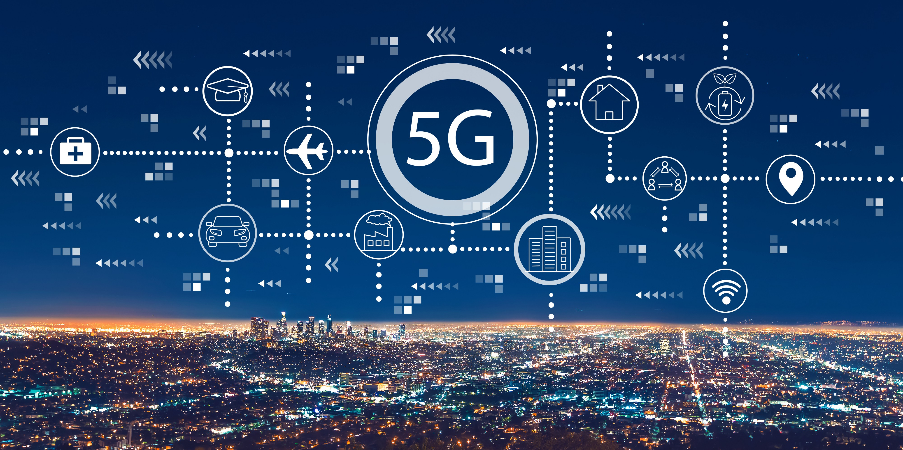
Getting the obvious one out of the picture first 5G Technology is the next generation of cellular networks and services. Expected speed Downlink – 20gbps Uplink - 10gbps

Slide 4
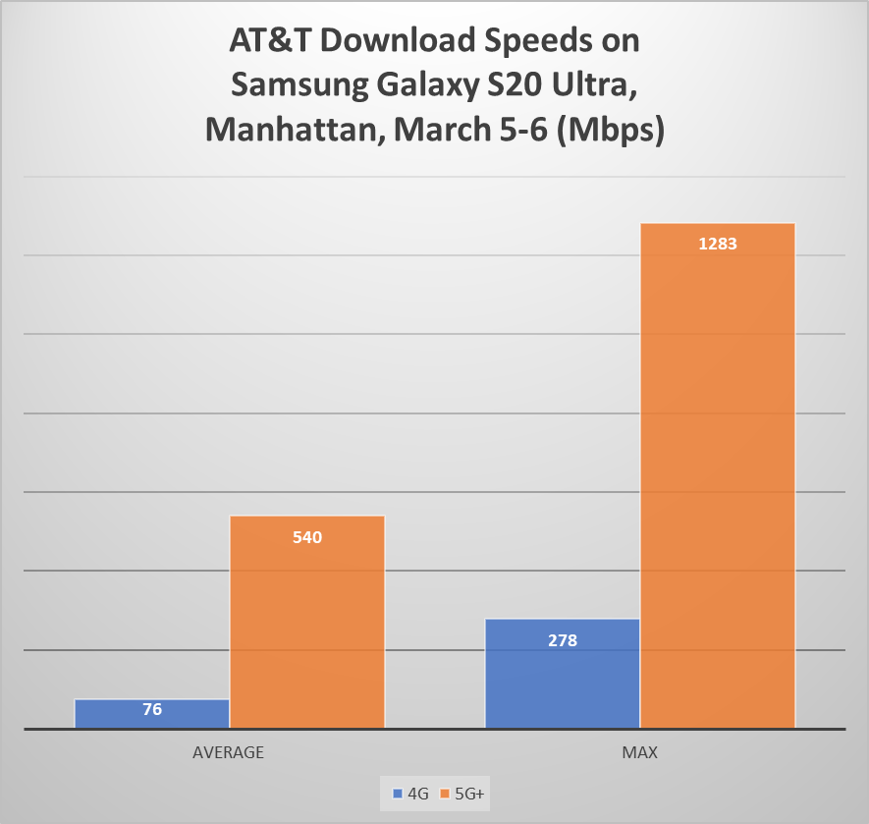
Key points
No one company or person owns 5G, but there are several companies within the mobile ecosystem that are contributing to bringing 5G to life.
5G is based on OFDM (Orthogonal frequency-division multiplexing), a method of modulating a digital signal across several different channels to reduce interference.
Like 4G LTE, 5G OFDM operates based on the same mobile networking principles. However, the new 5G NR air interface can further enhance OFDM to deliver a much higher degree of flexibility and scalability. This could provide more 5G access to more people and things for a variety of different use cases.

Slide 5
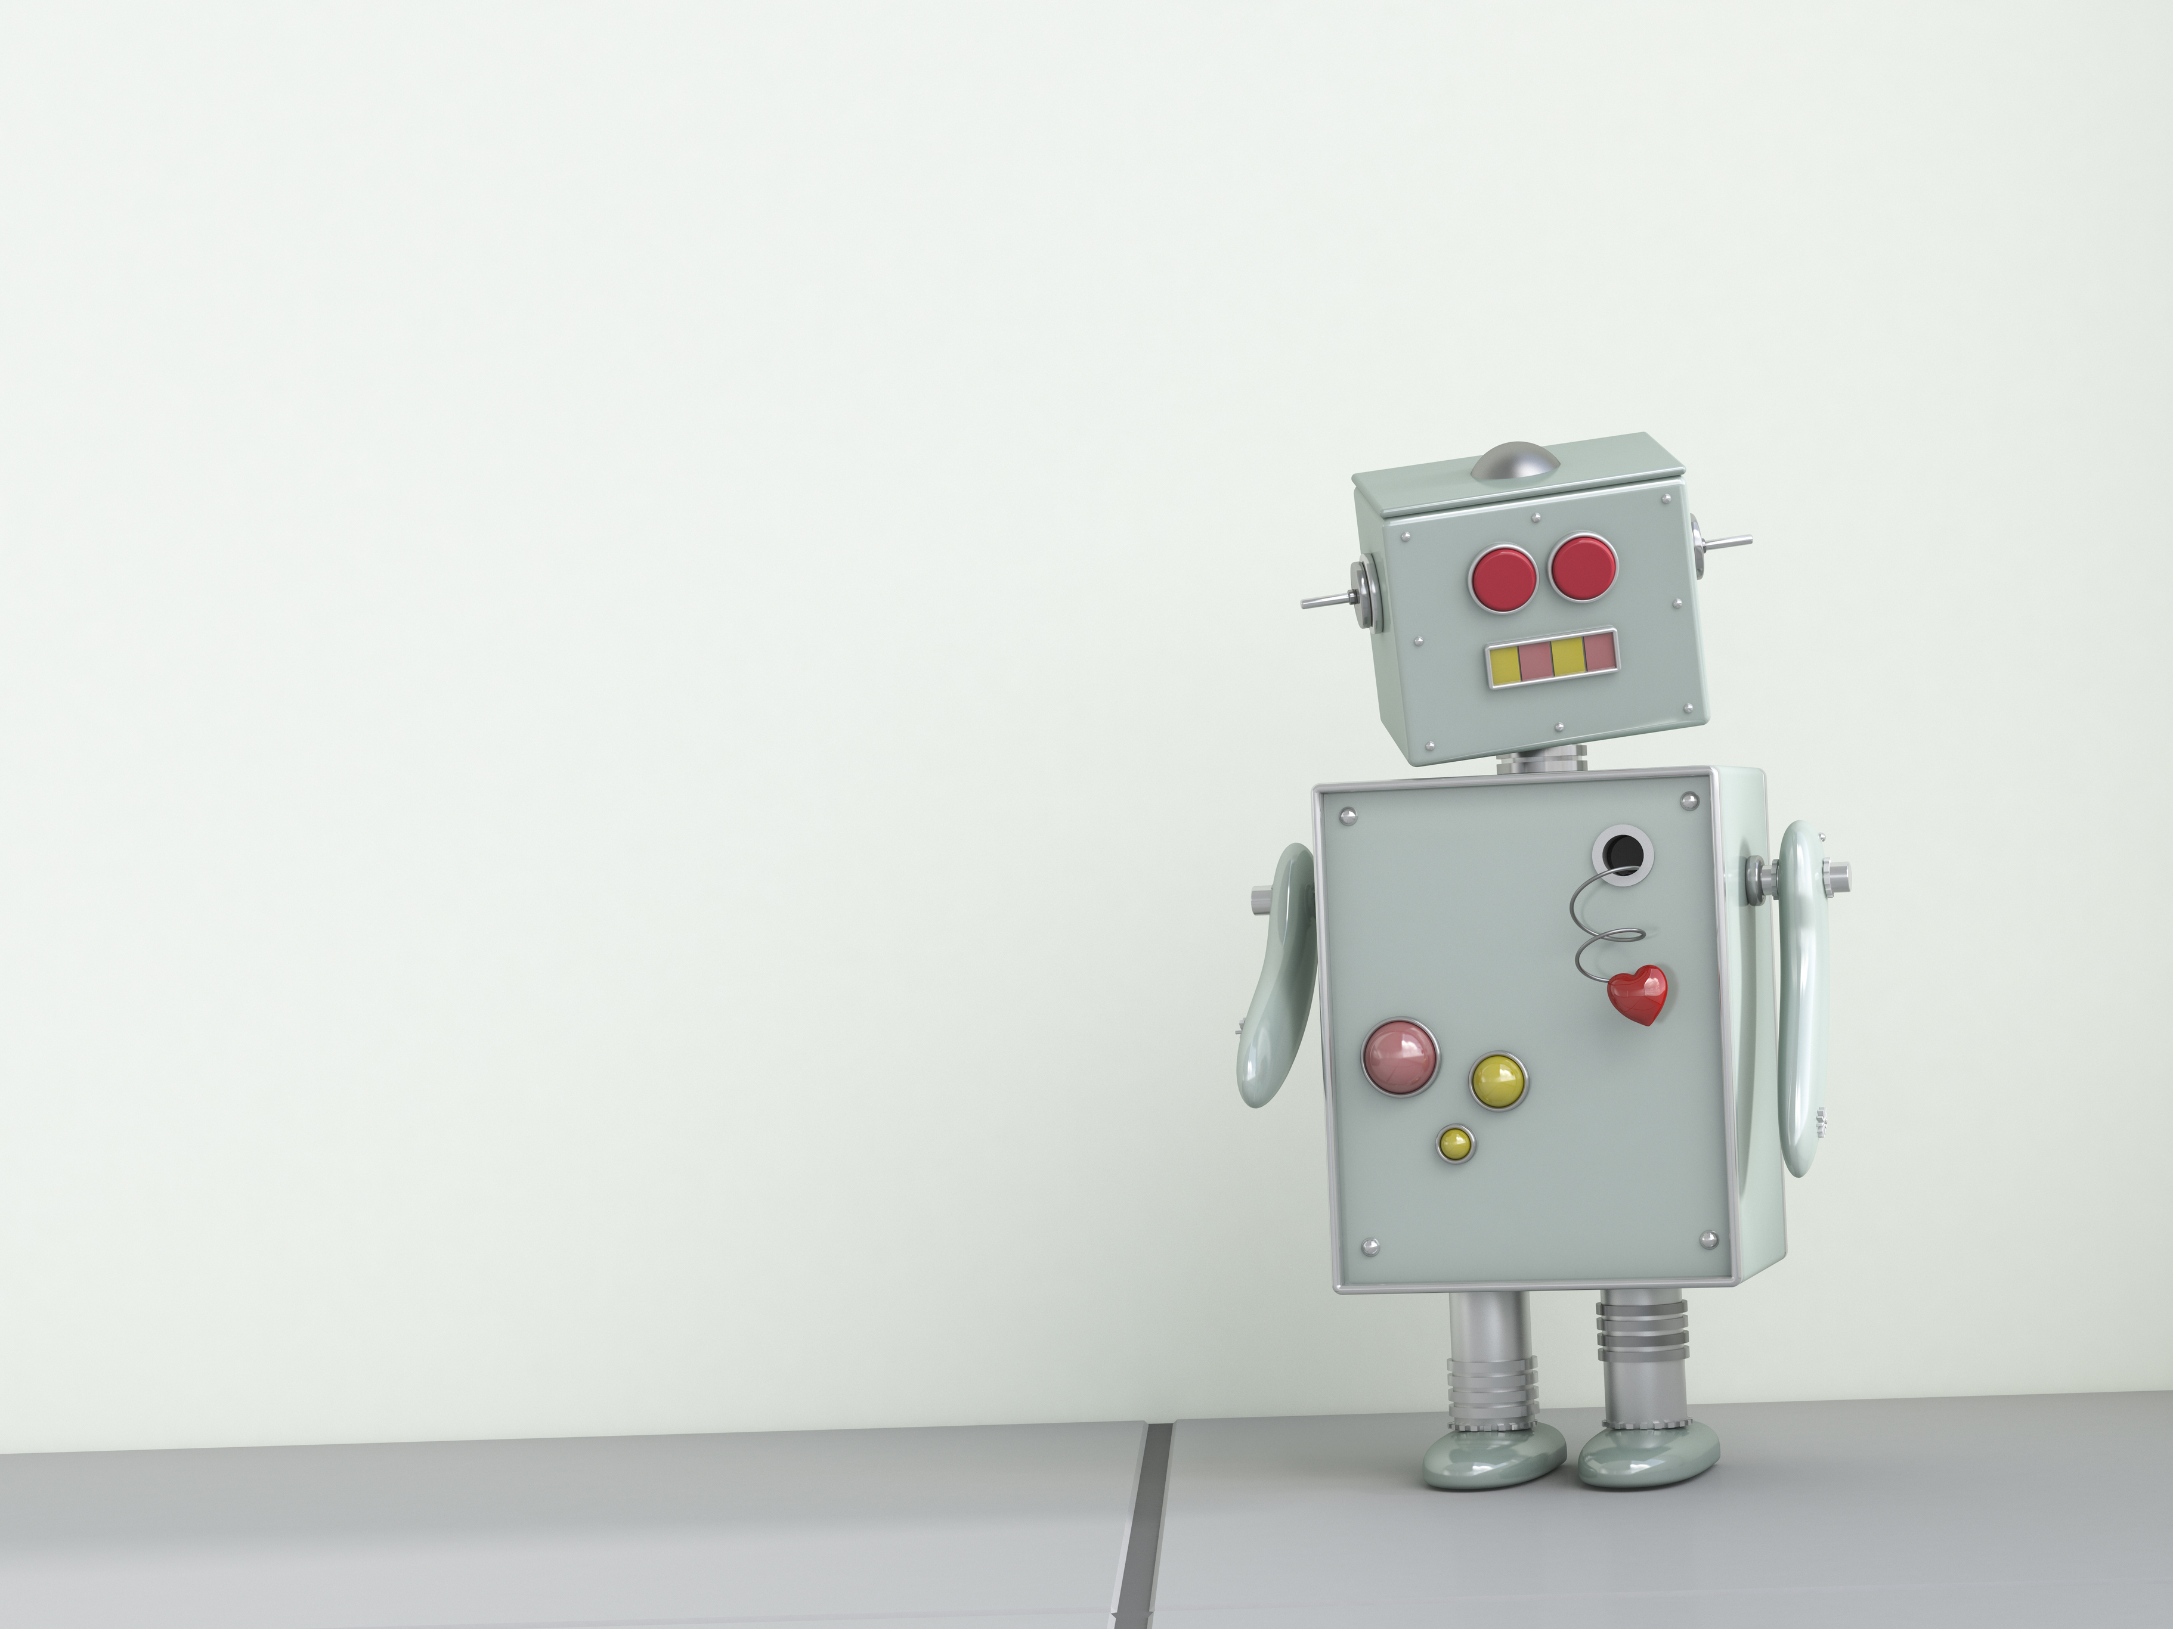
Intelligent Process Automation
A SIMPLE IDEA THAT ‘ANYTHING THAT CAN BE AUTOMATED SHOULD BE AUTOMATED’

Slide 6
Intelligent Process Automation. IPA, in a nutshell, allows bots to benefit from the abilities of Artificial Intelligence, Big Data, Machine Learning, meaning they can learn and improve over time. This helps these intelligent bots evolve from the ‘If-this-then-that’ rule. Some companies that were experimenting with IPA come up with results like
Automation of 50 to 70 percent of tasks . . .
. . . which has translated into 20 to 35 percent annual run-rate cost efficiencies . . .
. . . and a reduction in straight-through process time of 50 to 60 percent . . .
. . . with return on investments most often in triple-digit percentages.

Slide 7
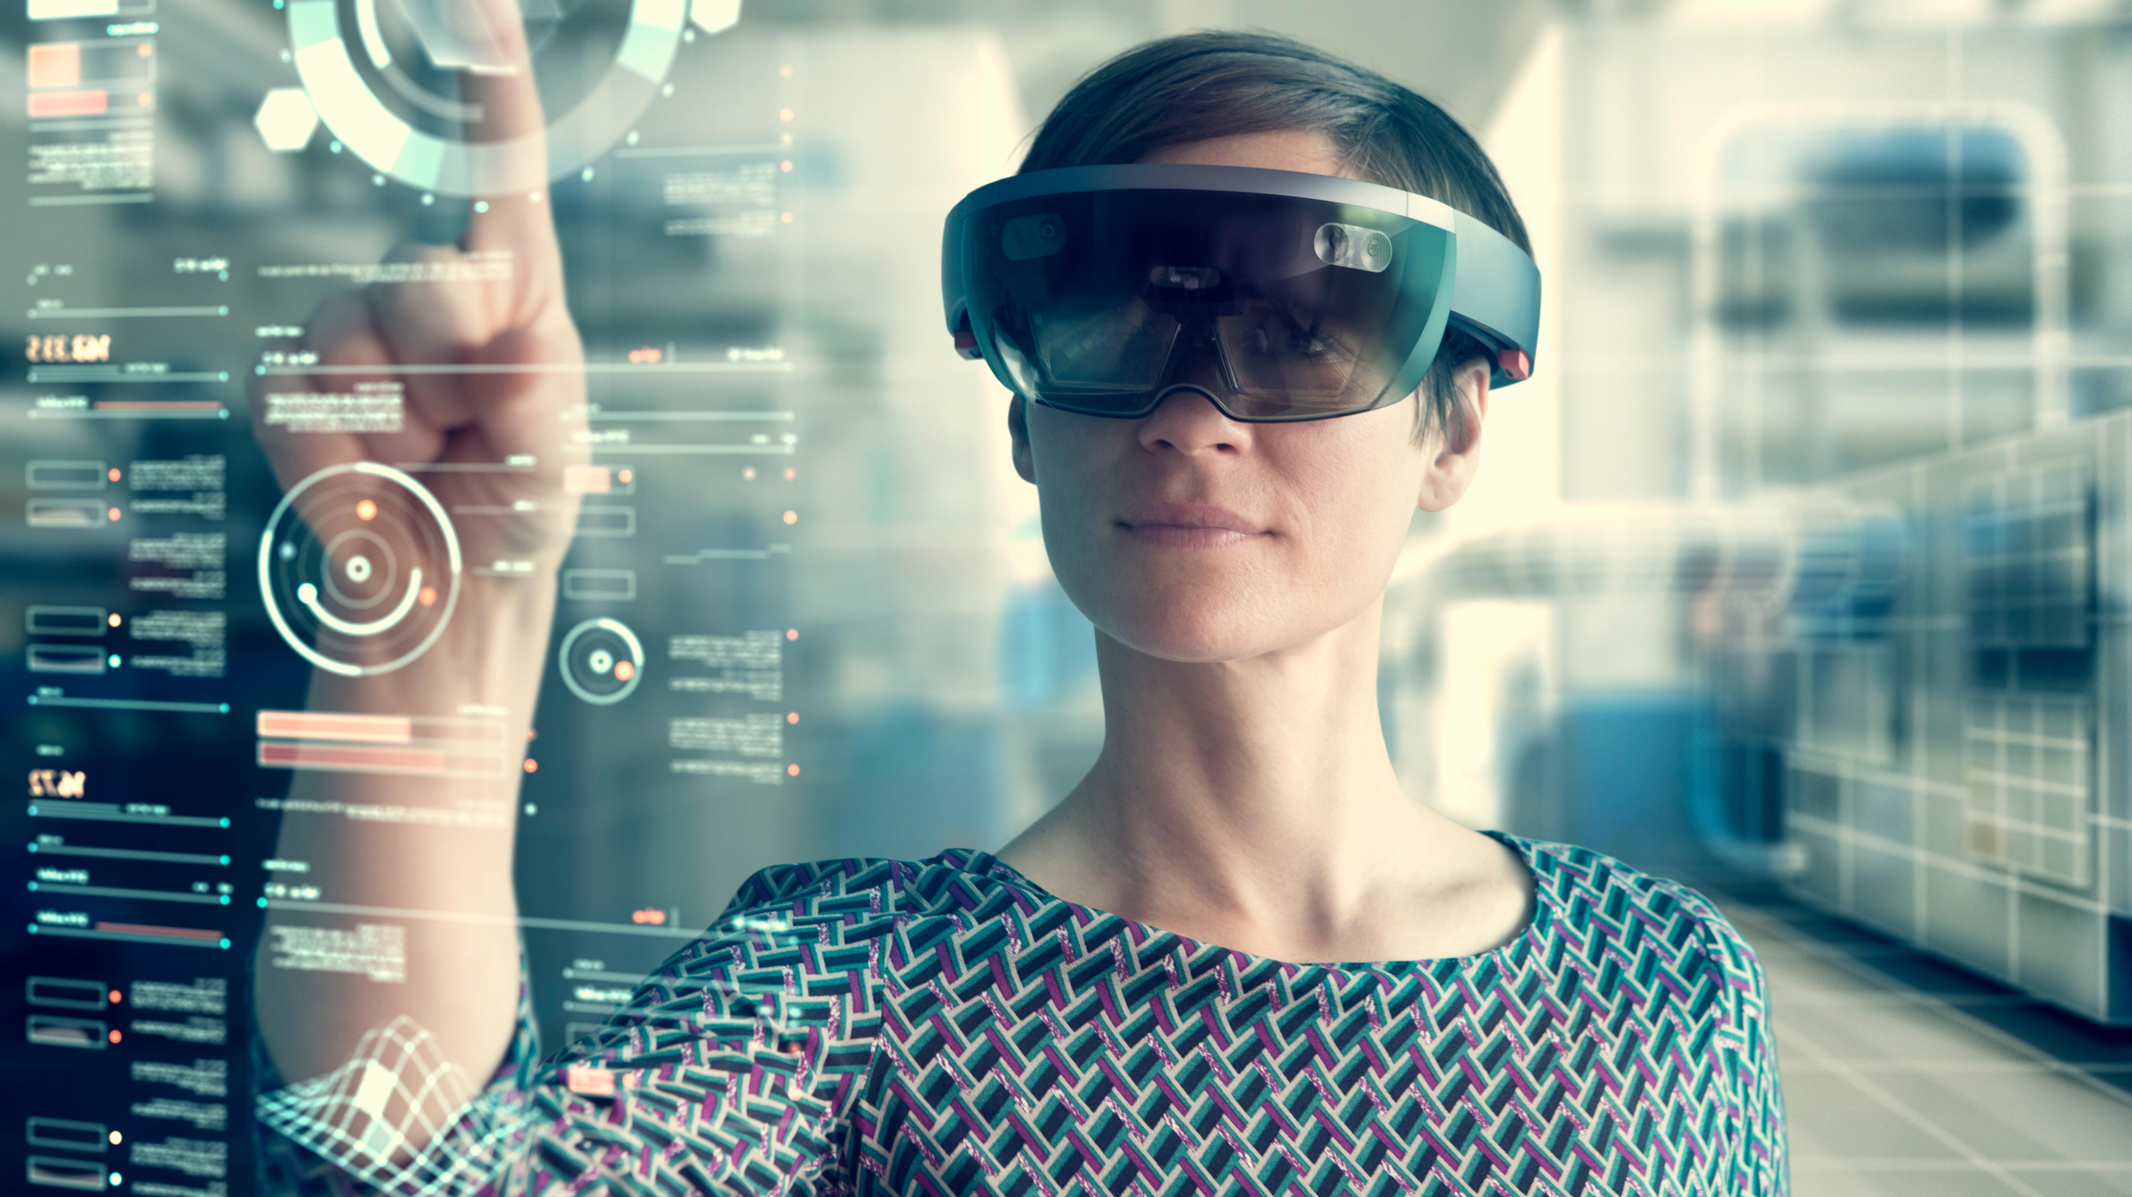
Virtual Reality
Virtual Reality (VR) is the use of computer technology to create a simulated environment

Slide 8
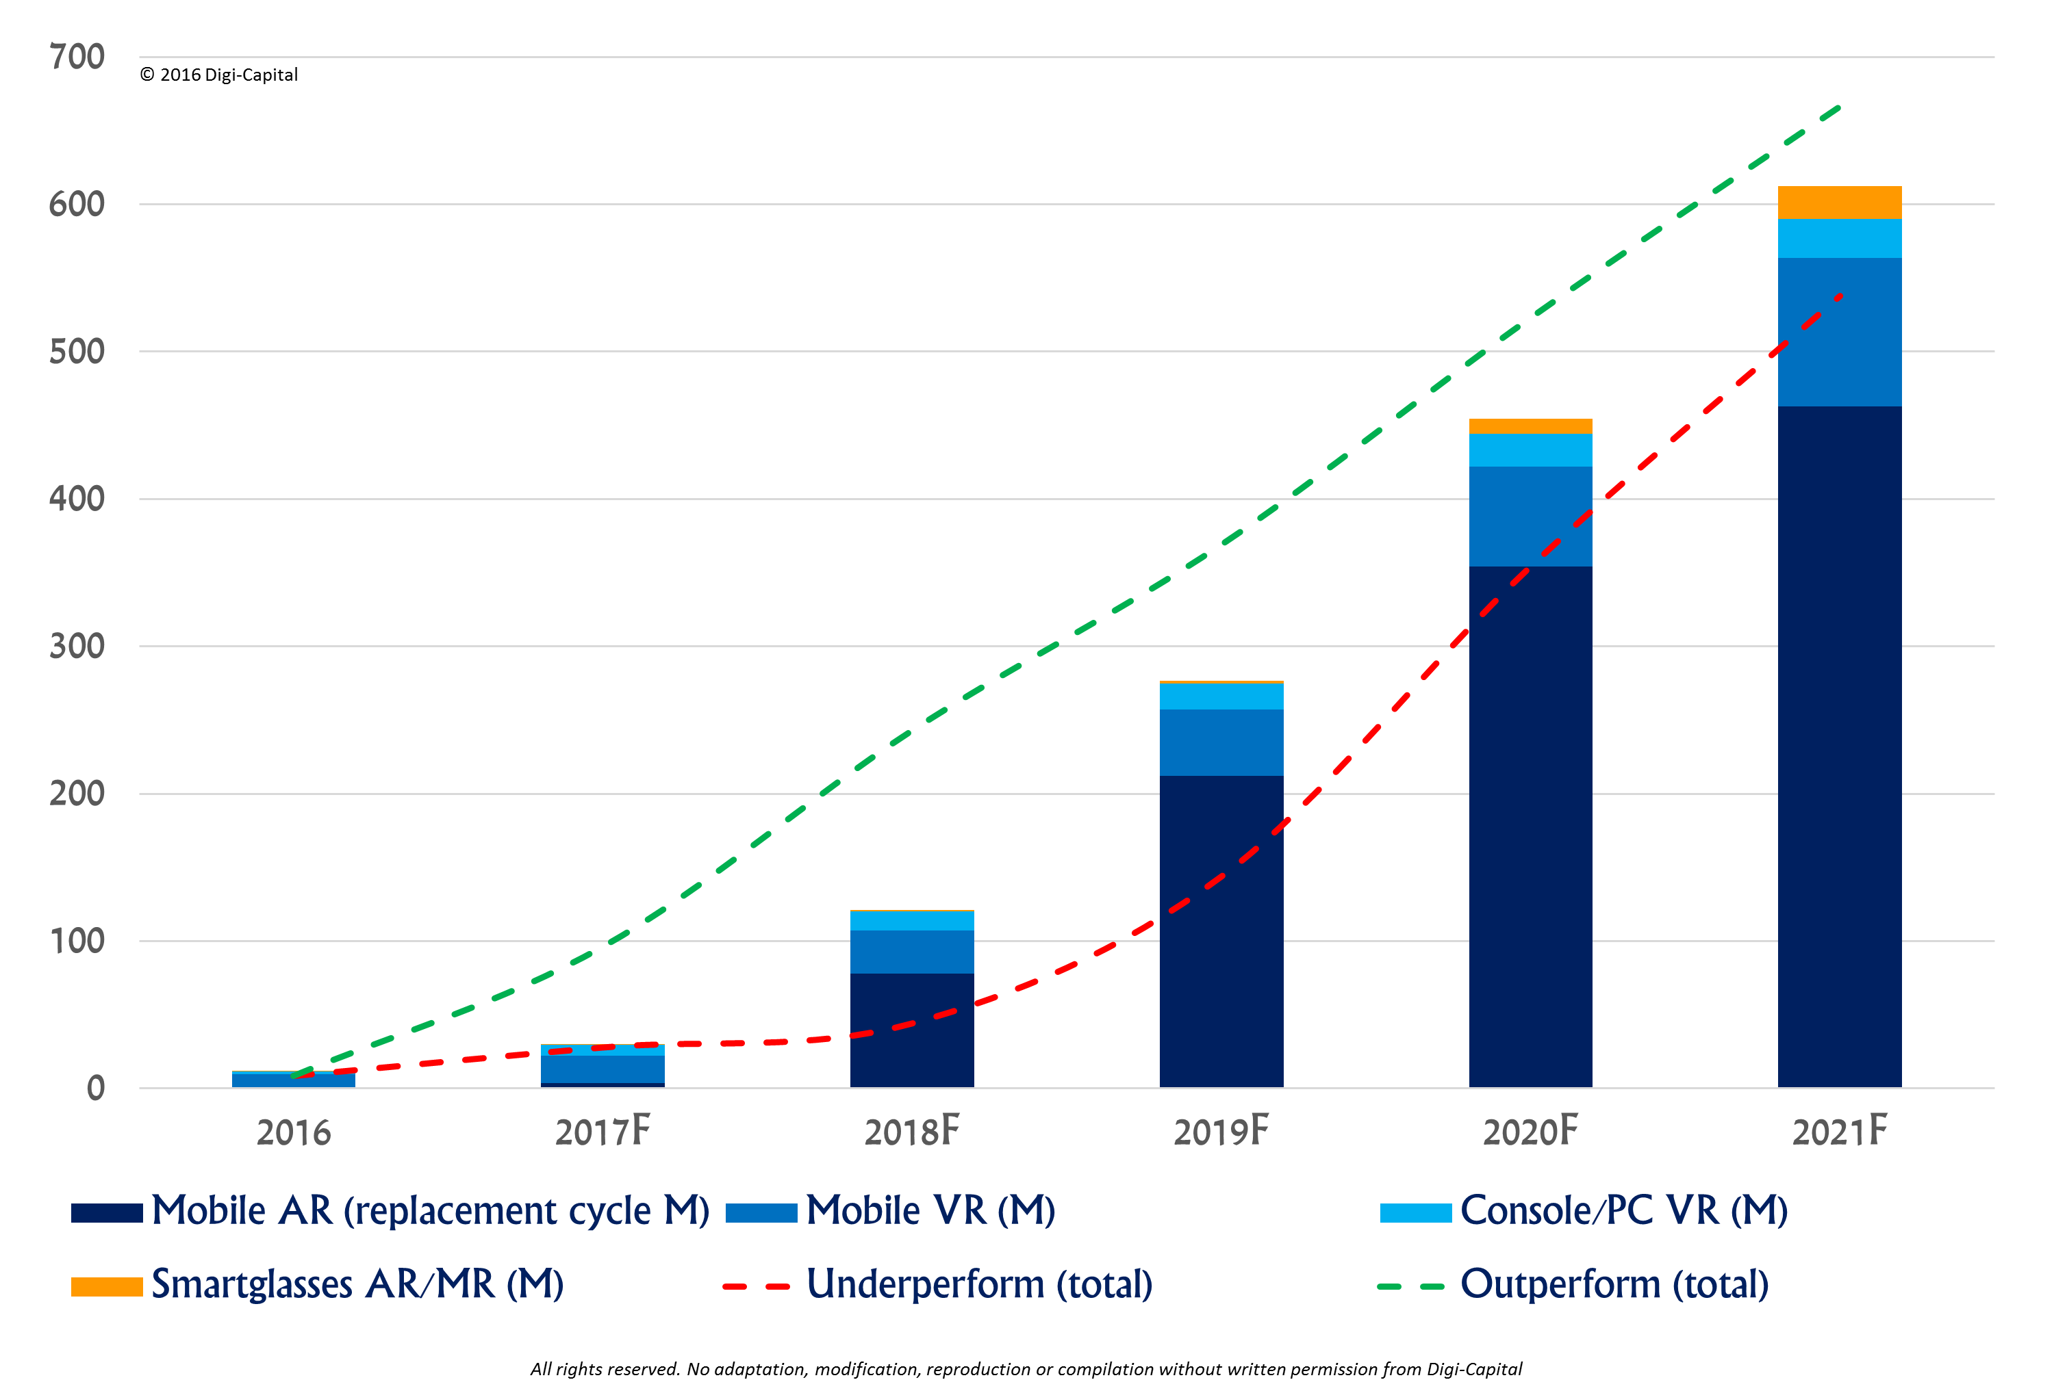
Virtual Reality
Virtual Reality and Augmented Reality are two sides of the same coin. You could think of Augmented Reality as VR with one foot in the real world: Augmented Reality simulates artificial objects in the real environment; Virtual Reality creates an artificial environment to inhabit.
In Augmented Reality, the computer uses sensors and algorithms to determine the position and orientation of a camera. AR technology then renders the 3D graphics as they would appear from the viewpoint of the camera, superimposing the computer-generated images over a user’s view of the real world.

Slide 9
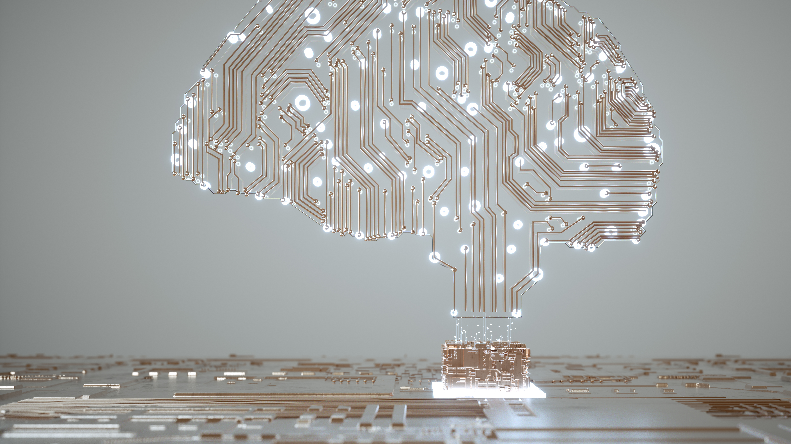
Human augmentation
Human Augmentation which basically means taking the help of technologies like Artificial Intelligence and Internet of Things, to not only enhance our daily lives but also to take human intelligence to the next level.

Slide 10

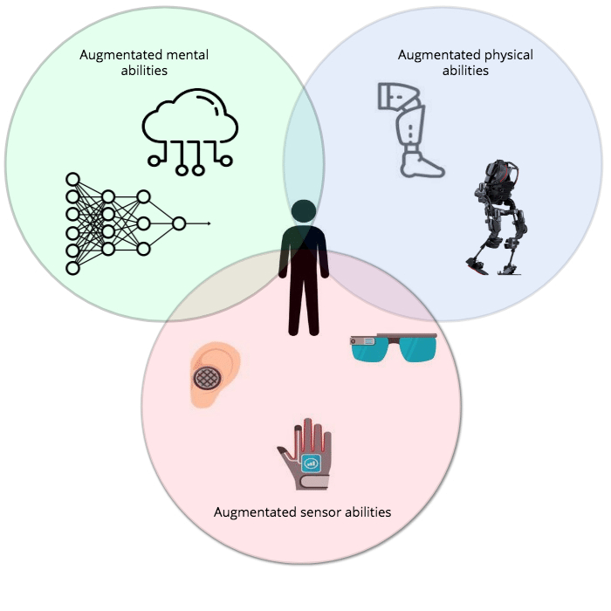
Human augmentation is a field of research that aims to enhance human abilities through medicine or technology.
The first level of human augmentation is replication. This refers to any augmentation that replicates something a typical person can already do. Some example would be
Naked Prosthetic
eSight
Motion Savvy
Bioprinting

Slide 11
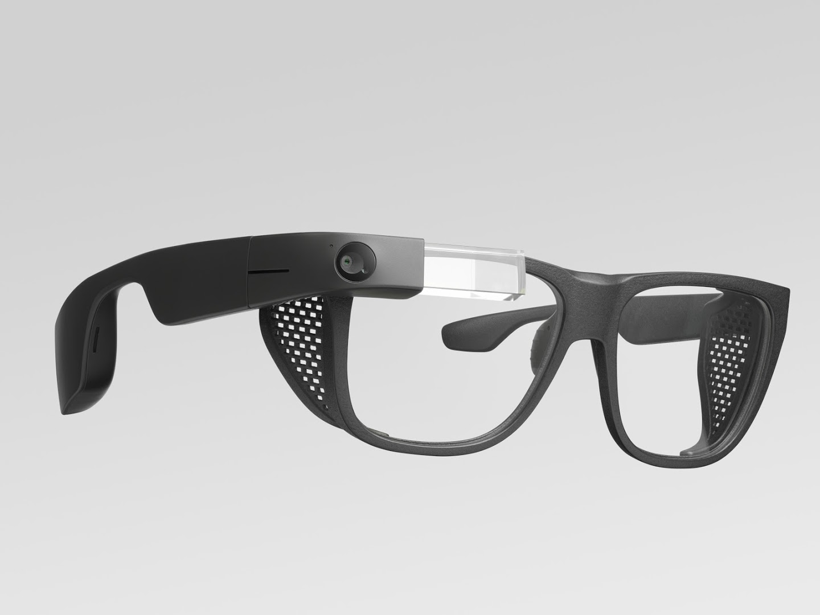

Supplementing human ability - This takes replication one step further by enabling us to do things that are already humanly possible, but better. Examples include
Exoskeletons
NeuraLink
Waverly Labs
Google Glass
Holo Lens 2

Slide 12
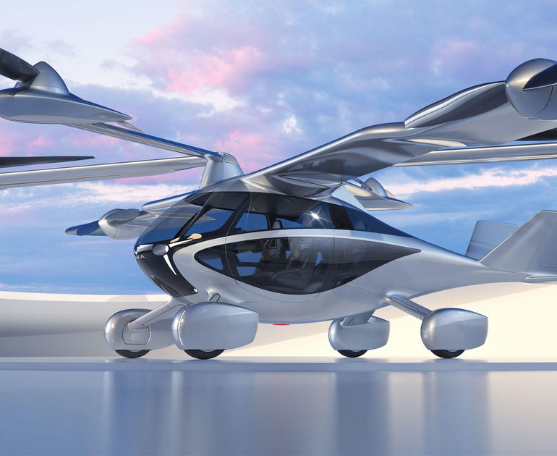

Exceeding Human Ability - The final level of human augmentation allows humans to exceed normal abilities. Example Includes Flying…
Zapata Flyboard Air
Invisibility Cloak
Artificial Blood Cell
Nanobot
Synthetic Memory Chip

Slide 13
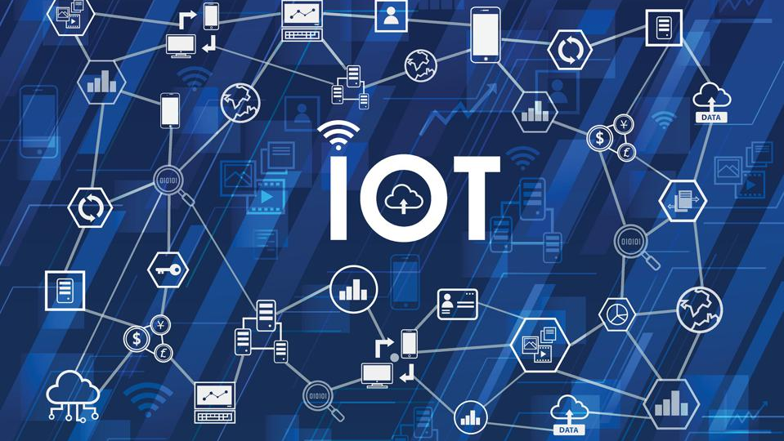
INTERNET OF THINGS Internet of things, or IOT, refers to the billions of physical devices around the world that are now connected to the internet, all collecting and sharing data.

Slide 14
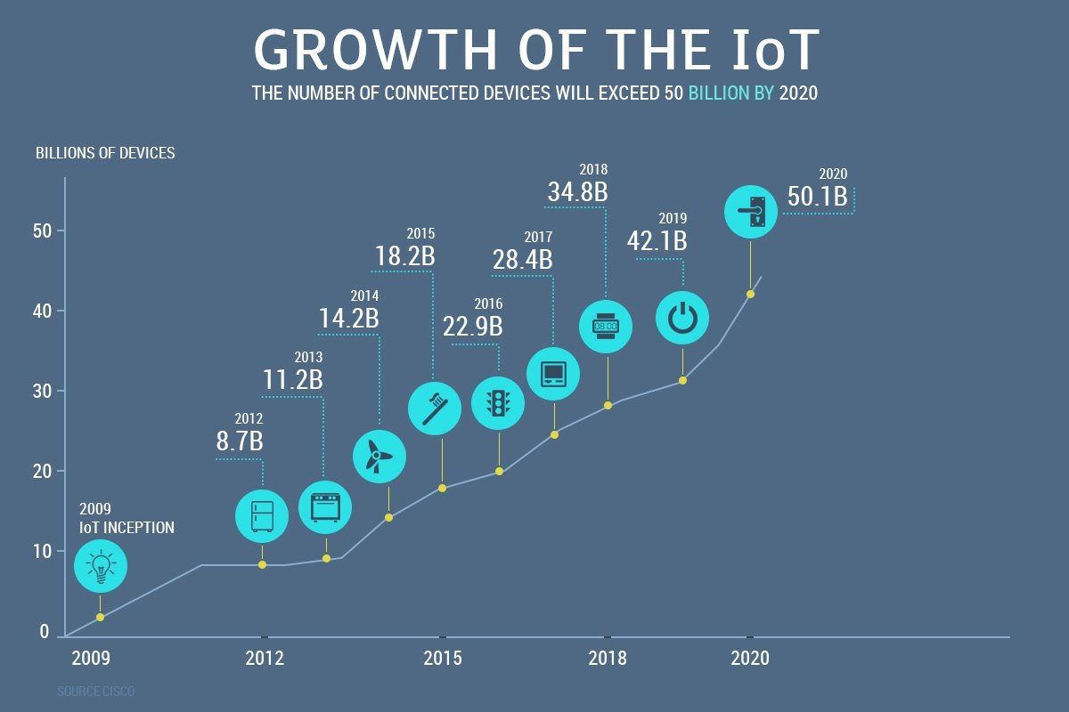

Slide 15
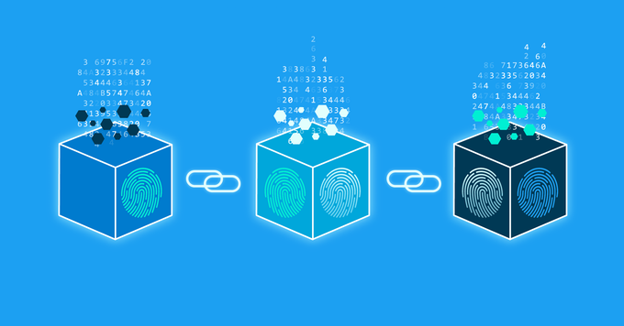
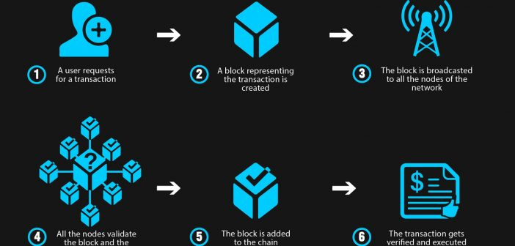
Blockchain A Blockchain is essentially a digital ledger of transactions that is duplicated and distributed across the entire network of computer systems on the Blockchain.

Slide 16
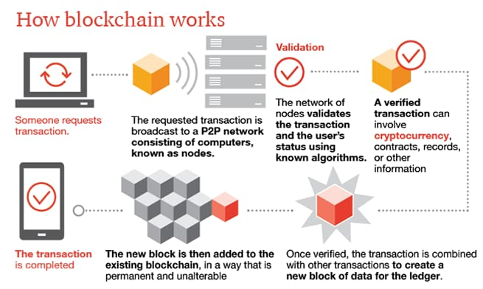
A simple analogy for understanding blockchain technology is a Google Doc. When we create a document and share it with a group of people, the document is distributed instead of copied or transferred. This creates a decentralized distribution chain that gives everyone access to the document at the same time.

Slide 17
A quick overview
A blockchain is a database that stores encrypted blocks of data then chains them together to form a chronological single-source-of-truth for the data
Digital assets are distributed instead of copied or transferred, creating an immutable record of an asset
The asset is decentralized, allowing full real-time access and transparency to the public
A transparent ledger of changes preserves integrity of the document, which creates trust in the asset.
Blockchain’s inherent security measures and public ledger make it a prime technology for almost every single sector

Slide 18
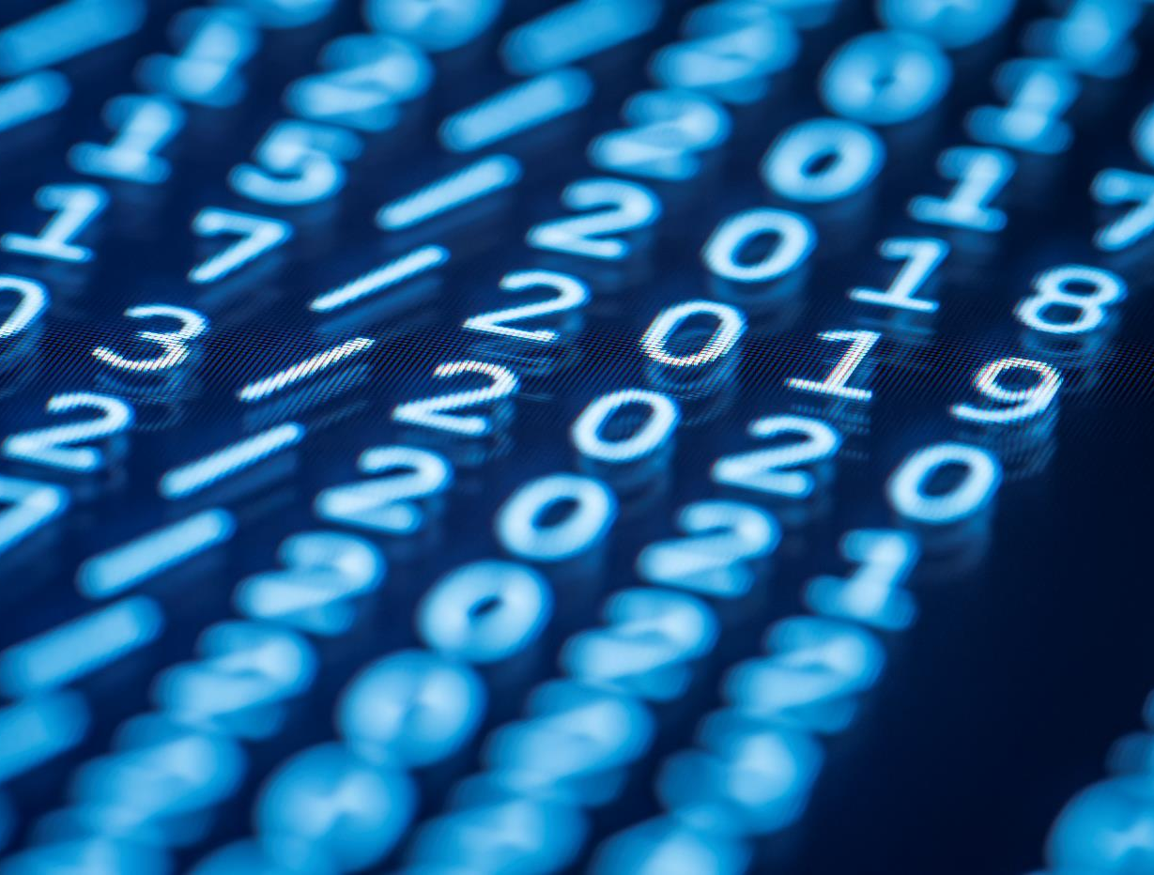
Thank You
Everyone for being with me through my presentation

